Slide 1
GIFTED EDUCATION SECTION, CDI, EDB
Learning and teaching
resources for
UPPER PRIMAry
levels
(English language)

Slide 2
Topic: | Healthy eating
Learning Objectives: | To learn about the importance of fruit and vegetables to keep us strong; To learn the features of acrostic poems; To create acrostic poems on their favourite fruit or vegetables with original and informed ideas; To enhance students’ creativity through language arts; and To develop reading, writing, listening and speaking skills.
Language Focuses: | To understand the features of an acrostic poem

Slide 3
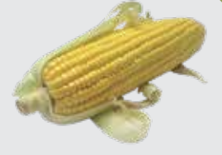
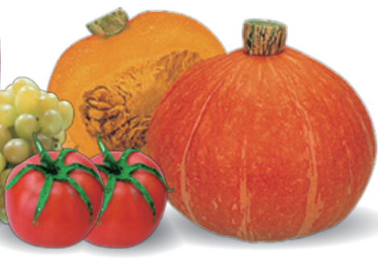
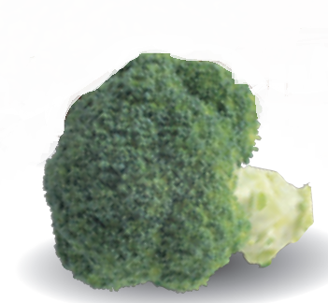
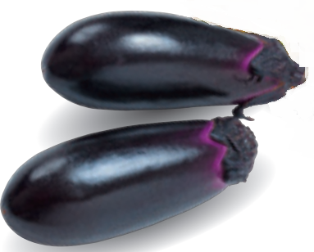
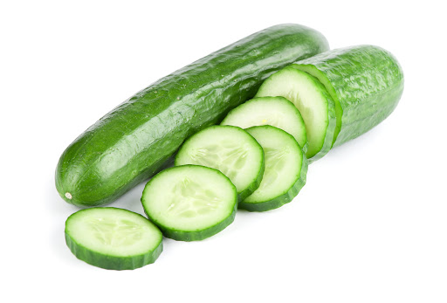
Part 1: Getting started
Do you know the English names of the fruit and vegetables in the photos? Let’s label them!
C _ _ _
P_ _ _ _ _ _
P _ _ _
T_ _ _ _ _
B _ _ _ _ _ _ _
C_ _ _ _ _ _ _
E_ _ _ _ _ _ _

Slide 4
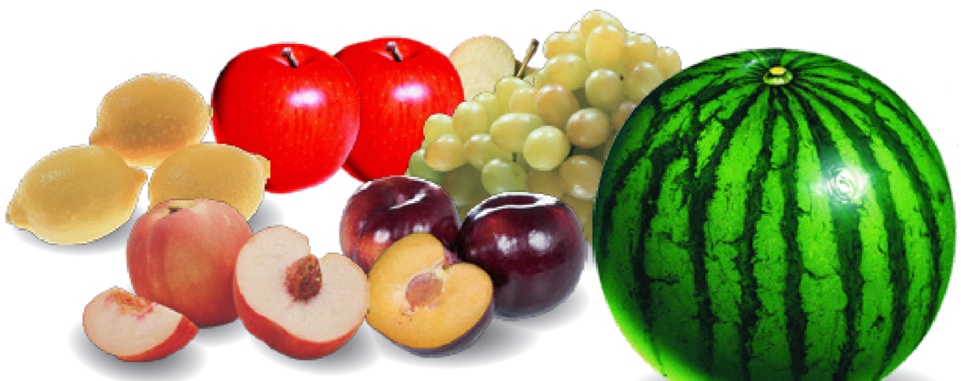
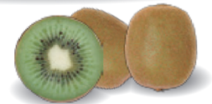
G _ _ _ _ _
W _ _ _ _ _ _ _ _ _
A _ _ _ _
L _ _ _ _
K _ _ _
P _ _ _ _
P _ _ _

Slide 5
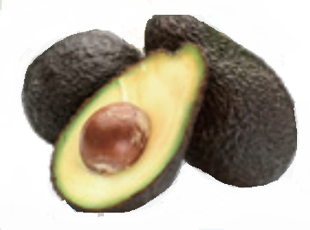
J _ _ _ _ _ _ _ _
B _ _ _ _ _
A _ _ _ _ _ _
G _ _ _ _
Click here for answers
SHARE WITH YOUR FAMILY/TEACHERS/FRIENDS
How many fruit and vegetables in the photos do you know?
Which one is your favourite? Why?
When do you eat it and how often do you eat it?
Reference: all photos are extracted from the website of Centre for Health Protection, Department of Health

Slide 6
Part 2: Reading & Listening – Knowing the Importance of Fruit and Vegetables
Miss Chan, your class teacher, wants you and your classmates to stay healthy during the outbreak of COVID-19. She told you that in order to improve health and reduce risks of getting COVID-19, it is really important for you to have enough fruit and vegetables every day. She sent you a video (Slide 7) to watch and asked you to answer Questions 1 to 3.

Slide 7
How many servings of fruit should we have every day?
People usually have fruit and vegetables in every meal. What other time can we have fruit and vegetables?
Fill in the blanks with appropriate words from the video:
It is important for us to have
enough fruit and vegetables
every day because fruit and
vegetables can _______ the risk of many __________diseases.
Reference:
https://www.isd.gov.hk/eng/tvapi/19_md314.html
Watch the video HERE
Click here for answers

Slide 8
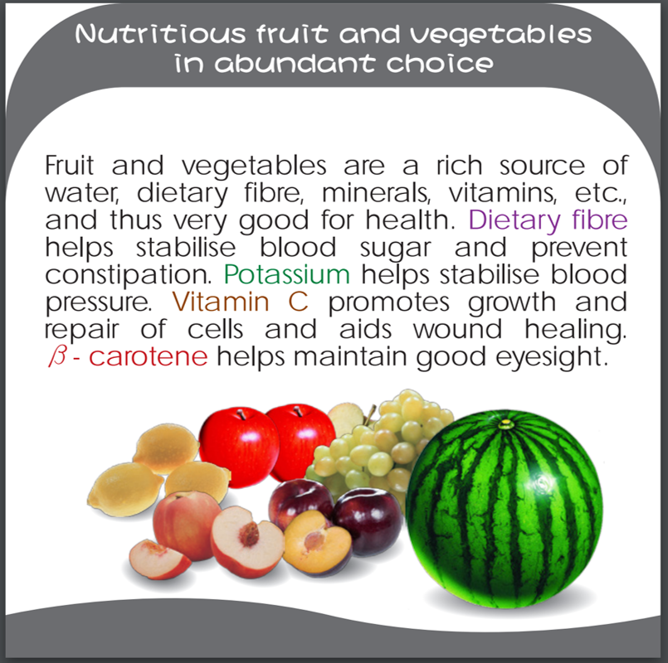
After watching the video, you look for more information about fruit and vegetables on the website of Centre for Health Protection. Read the information and answer Questions 4 to 7.
What makes fruit and vegetables good for our health?
Your friend, John, spends so much time on his smartphone that he has started to have blurred vision. He should eat more fruit and vegetables because they contain:
A. dietary fibre
B. potassium
C. vitamin C
D. β - carotene
Click here for answers
Reference: https://www.chp.gov.hk/files/her/ct_eng_w3c.pdf

Slide 9
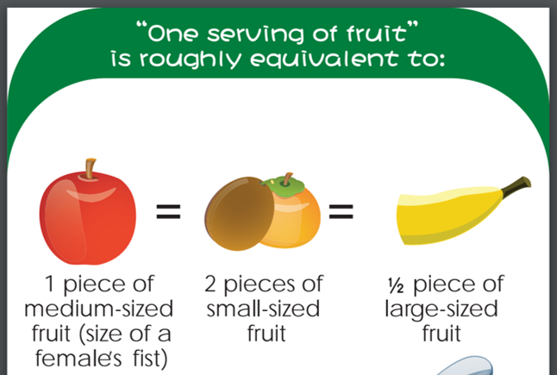
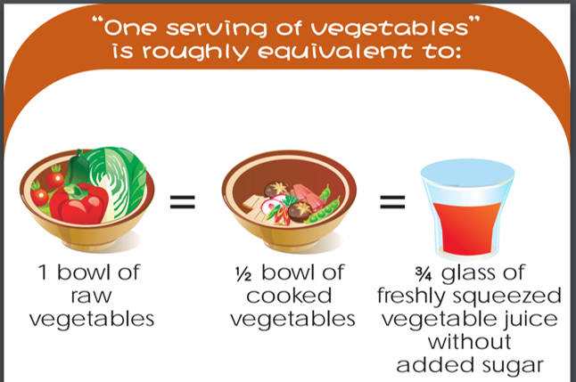
Which photo below shows a fist?
A. B.
C.
Jack has two glasses of fresh tomato juice and a medium-sized banana today. Does he have enough fruit and vegetables intake for a day?
Click here for answers
Reference: https://www.chp.gov.hk/files/her/ct_eng_w3c.pdf

Slide 10
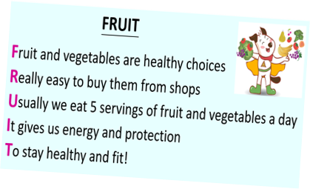
Part 3: Learning about Acrostic Poems
What are acrostic poems?
An acrostic poem is a poem where the first letters of each line spell
out a specific word vertically that acts as the theme of the poem
and lines can be made up of single word or phrases. All the lines
in an acrostic poem are written about the focus word.
Easy steps to write acrostic poems
1. | Decide what to write about (the focus word).
2. | Write your word down vertically.
3. | Brainstorm words or phrases that describe your word.
4. | Create an acrostic poem using the vocabulary you brainstormed.

Slide 11
Read poem 1 and know more about acrostic poems.
Poem 1:
A title (the name of the thing you describe)
FRUIT
F ruit and vegetables are healthy choices
Really easy to buy them from shops
Usually we eat 5 servings of fruit and vegetables a day
I t gives us energy and protection
T o stay strong and fit!
The first letters of each line spell out the word “FRUIT” (the focus word and title of the poem)
Ideas in the lines are
all about fruit
(e.g. healthy choices, 5 servings, energy, protection, stay strong and fit)
You could write the first letter in bold, or colour it to make the letters of the focus word stand out more!

Slide 12
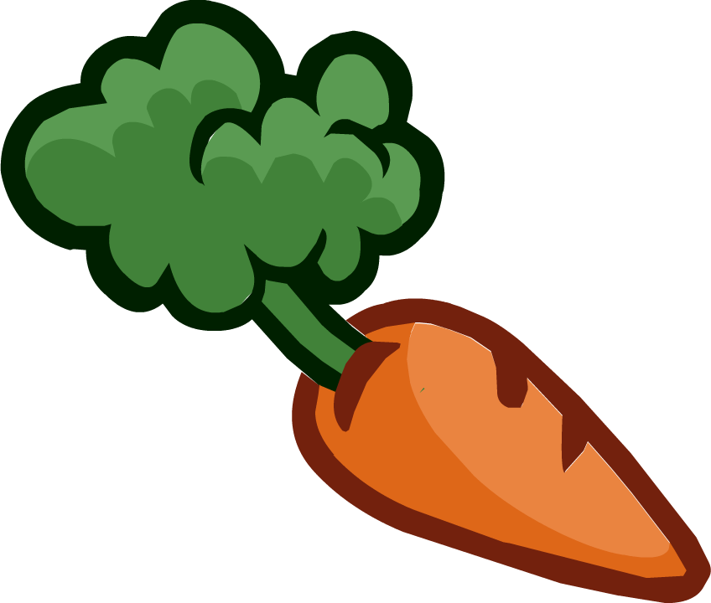
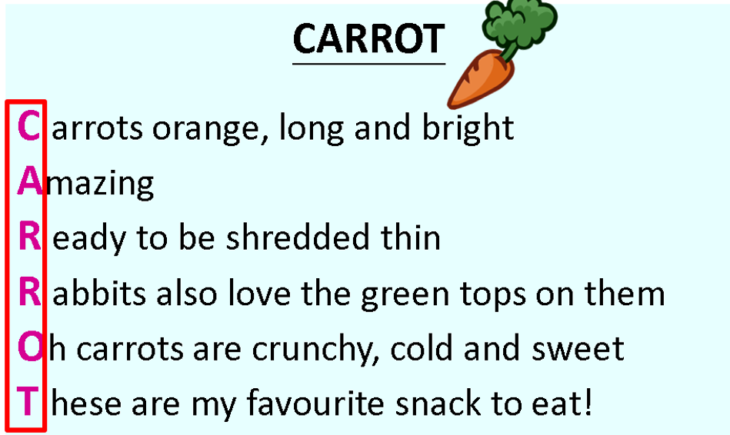
Read Poem 2 and find out how the use of descriptive language can enrich your poem and make it interesting!
Poem 2:
CARROT
Carrots orange, long and bright
Amazing
Ready to be shredded thin
Rabbits also love the green tops on them
Oh carrots are crunchy, cold and sweet
These are my favourite snack to eat!
Lines can be made up of single word or phrases
“Sweet” and “Eat” rhyme
The first letters of each line spell out the word “CARROT”
Extended Learning
Click HERE to learn more about rhyme in poems!

Slide 13
The poet describes carrots in different ways. Can you identify them? Look at the adjectives carefully and circle them.
CARROT
Carrots orange, long and bright
Amazing
Ready to be shredded thin
Rabbits also love the green tops on them
Oh carrots are crunchy, cold and sweet
These are my favourite snack to eat!

Slide 14
Areas described | Adjectives in the poem
Taste | ______________
____________ | orange green _____________
Parts | green tops
____________ | long thin
Texture | ______________
Read the acrostic poem “Carrot” again and fill in the table on the right.
Click here for answers

Slide 15
Part 4 : Writing Task (An Acrostic Poem)
Create an acrostic poem on your favourite fruit or vegetables making use of the choice board below.
You may even illustrate your poem!
size | colour | shape | others
taste | texture | parts

Slide 16
You may work on any ONE of the levels below.
(a) Brainy Beginner
Create an acrostic poem on one of your favourite fruit or vegetables. Please describe your favourite fruit or vegetables on any one or two area(s) from the choice board. Make sure your poem has at least four lines.
(b) Logical Learner
Create an acrostic poem on one of your favourite fruit or vegetables. Please describe your favourite fruit or vegetables on any three or four areas from the choice board. Make sure your poem has at least five lines.
(c) Creative Challenger
Create TWO acrostic poems on your favourite fruit or vegetables. Please describe your favourite fruit or vegetables on more than four areas from the choice board (preferably ideas on “others”). Make sure each poem has at least five lines.

Slide 17
Self-evaluation
Use the checklist below to evaluate your work. Put a tick in the appropriate boxes.
□ My poem includes a title and I have written the title in capital letters. □ I have started each line with the correct letter from the fruit/vegetables I choose. □ I describe my favourite fruit/vegetables with details using the choice board. □ (For Creative Challenger) I describe my favourite fruit/vegetables in at least two areas on “Others” from the choice board. □ All the lines in the poem are about my favourite fruit/vegetables. □ I use new and interesting vocabulary. □ I have checked my spelling carefully.

Slide 18
Extended Learning : Rhyming words
What is a rhyme?
A rhyme is a repetition of similar sounding words, often occurring at the end of lines in poems or songs. A rhyme can bring rhythm or musicality to poems.
Watch the ETV on the right and
listen to Uncle Teddy’s rhyme
(video from 3’58” to 5’36”) to
know more about rhyming words!
Watch the ETV HERE
Reference:
https://www.hkedcity.net/etv/resource/514153493

Slide 19
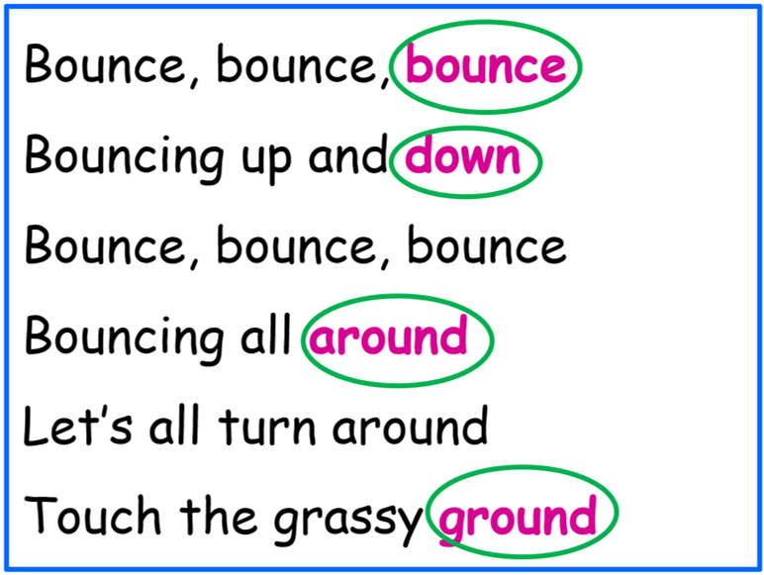
Do you remember the rhyme Uncle Teddy performed in the ETV? Read the rhyme below and circle the rhyming words!
Bounce, bounce, bounce
Bouncing up and down
Bounce, bounce, bounce
Bouncing all around
Let’s all turn around
Touch the grassy ground
“Bounce”, “down”, “around” and “ground” have the
same end sound /ʊnd/
They are
rhyming words!

Slide 20
Extended activity
Part A: Draw a line connecting each word on the left with a word on the right that rhymes with it. One has been done for you as example.
see
tapes
kites
change
If you are not sure how the words sound, check the online dictionaries (links on slide 24) and listen to the pronunciations!
sink
door
orange
Kong
grapes
pink
potato
radio
strong
tree
floor
nights

Slide 21
Suggested Answers
How many correct pairs of rhyming words do you have?
see
tapes
kites
change
sink
door
orange
Kong
grapes
pink
potato
radio
strong
tree
floor
nights

Slide 22
Extended activity
Part B: Read the acrostic poem below, can you find all the rhyming words? Circle them.
One word is missing in the last line, can you think of a word to fill in the blank? The word should rhyme with “sour”.
Grapes are juicy and sweet
Really tasty on the vine
Amazingly fresh in the heat
Purple or green are fine
Even if the grapes are sour
Surely they can give you ___________

Slide 23
Suggested Answers
“sweet” rhymes with “heat”
“vine” rhymes with “fine”
Grapes are juicy and sweet
Really tasty on the vine
Amazingly fresh in the heat
Purple or green are fine
Even if the grapes are sour
Surely they can give you ___________
power
Some words that rhyme with “sour”:
power, hour, tower, flower, flour, shower, empower, our
Which word fits in the blank and suits the meaning?
Go back to Slide 12

Slide 24
WORD WHIZ
Visit the following dictionary web sites (in alphabetical order) to learn more about the pronunciation, definition and usage of words:
1. Cambridge Dictionary
https://dictionary.cambridge.org/
2. Oxford Learner’s Dictionaries
https://www.oxfordlearnersdictionaries.com/

Slide 25
After knowing about the importance and benefits of having fruit and vegetables every day, why don’t you learn to cook some healthy fruit and vegetable meals with your family?
Visit the following websites of the Centre for Health Protection, Department of Health to get some recipes:
https://www.chp.gov.hk/en/resources/e_health_topics/12472.html

Slide 26
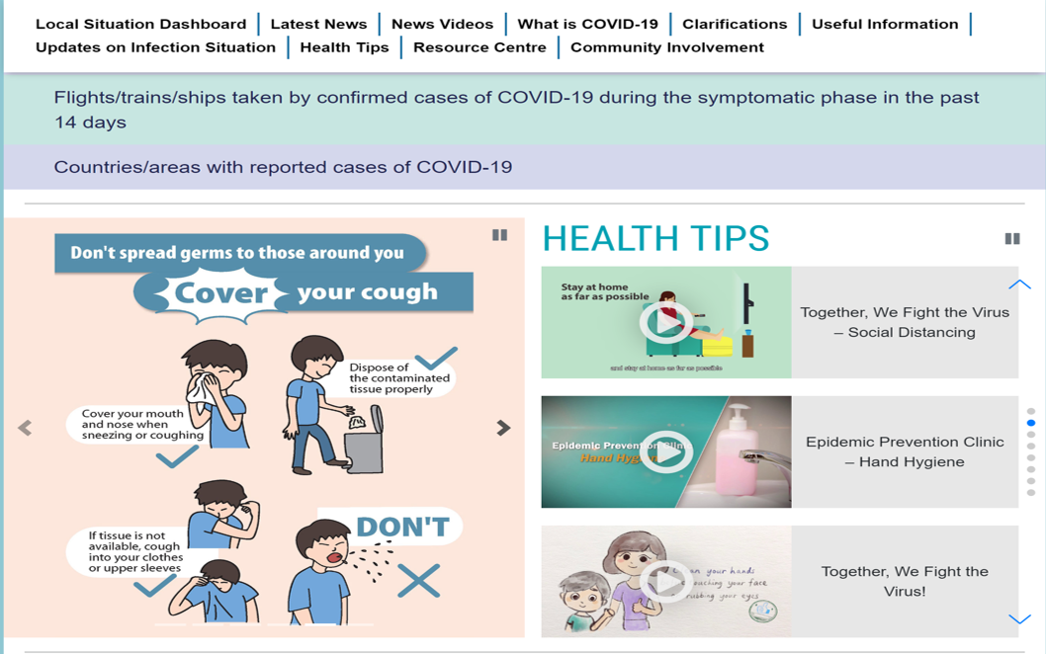
For more information on combatting COVID-19, please visit the website of the Centre for Health Protection, Department of Health:
https://www.coronavirus.gov.hk/eng/index.html

Slide 27
Part 1: Getting started (Slides 3 – 5)
Suggested Answers
Do you know the English names of the fruit and vegetables in the photos? Let’s label them!
C o r n
P u m p k i n
P e a s
T o m a t o
B r o c c o l i
C u c u m b e r
E g g p l a n t

Slide 28
Suggested Answers
G r a p e s
W a t e r m e l o n
A p p l e
L e m o n
K i w i
P e a c h
P l u m

Slide 29
Suggested Answers
J a c k f r u i t
A v o c a d o
B a n a n a
G u a v a
Go to Part 2
Reference: all photos are extracted from the website of Centre for Health Protection, Department of Health

Slide 30
Suggested Answers
(Slide 7)
Part 2: Reading & Listening – Knowing the Importance of Fruit and Vegetables
How many servings of fruit should we have every day?
Two/ 2 servings of fruit
People usually have fruit and vegetables in every meal. What other time can we have fruit and vegetables?
We can have fruit and vegetables as snack.
3. Fill in the blanks with appropriate words from the video:
It is important for us to have enough fruit and vegetables every day
because fruit and vegetables can reduce the risk of many chronic
diseases.
Go back to Reading

Slide 31
Suggested Answers
(Slide 8)
What makes fruit and vegetables good for our health?
It is a rich source of water, dietary fibre, minerals, vitamins, etc.
Your friend John spends a lot of time on his smartphone that he starts to have blurred vision, he should eat more fruit and vegetables because they contain:
A. dietary fibre
B. potassium
C. vitamin C
D. β - carotene
Go back to Reading

Slide 32
Suggested Answers
(Slide 9)
Which photo below shows a fist?
A. B. C.
Jack has two glasses of fresh tomato juice and a medium-sized banana today. Does he have enough fruit and vegetables intake for a day?
No, he needs 2 servings of fruit and 3 servings of vegetables
every day. But he only has 2 servings of fruit (a banana) and a
little more than 2 servings of vegetables (2 glasses of tomato
juice).
Go to Part 3

Slide 33
Part 3: Learning about Acrostic Poems (Slide 14)
Suggested Answers
Areas described | Adjectives in the poem
Taste | sweet
Colour | orange green bright
Parts | green tops
Shape | long thin
Texture | crunchy
Go to Part 4

Slide 34
Stay Positive and Be Proactive!
Together, We Fight Against the Virus!

